Slide 1

MEDIA
CLASSROOM
S to T
T to S
S to S
POLICY
SCHOOL
SOCIETY
DISTRICT
COMMUNITY
GREATER IMPACT ON STUDENT LEARNING
Notes:
Wil + Julius

Slide 2
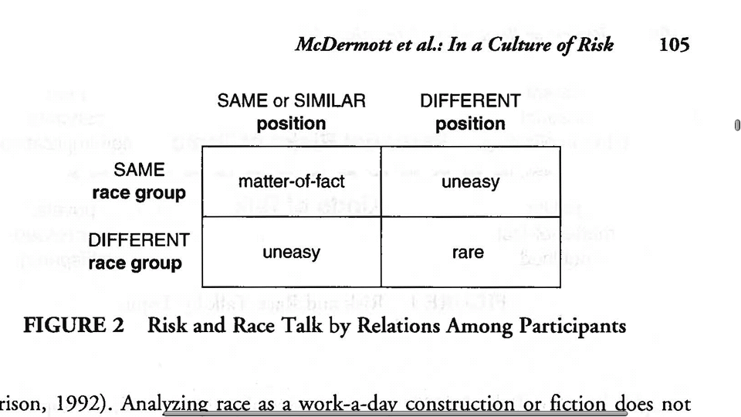
Risk and Race Talk by Relations Among Participants
McDermott, Raley, & Seyer-Ochi (2009)
Notes:
3 to 5 minutes Wil
Split up entire table and get with Thinking partner

