Slide 1
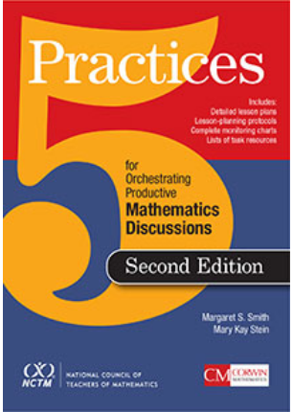
5 Practices for Orchestrating Productive Mathematics Discussions
Anticipating student responses prior to the lesson
Monitoring students’ work on and engagement with the task
Selecting particular students to present their mathematical work
Sequencing students’ responses in a specific order for discourse
Connecting different students’ responses, and connecting the responses to the key mathematical ideas

